Slide 1

MALAIGNANT COMMENTS CLASSIFICATION
Submitted by:
Praveen Pandey

Slide 2
Business Problem Our goal is to build a prototype of online hate and abuse comment classifier which can used to classify hate and offensive comments so that it can be controlled and restricted from spreading hatred and cyberbullying.
The proliferation of social media enables people to express their opinions widely online. However, at the same time, this has resulted in the emergence of conflict and hate, making online environments uninviting for users. Although researchers have found that hate is a problem across multiple platforms, there is a lack of models for online hate detection. Online hate, described as abusive language, aggression, cyberbullying, hatefulness and many others has been identified as a major threat on online social media platforms. Social media platforms are the most prominent grounds for such toxic behavior.
There has been a remarkable increase in the cases of cyberbullying and trolls on various social media platforms. Many celebrities and influences are facing backlashes from people and have to come across hateful and offensive comments. This can take a toll on anyone and affect them mentally leading to depression, mental illness, self-hatred and suicidal thoughts.

Slide 3
Business Problem Our goal is to build a prototype of online hate and abuse comment classifier which can used to classify hate and offensive comments so that it can be controlled and restricted from spreading hatred and cyberbullying.
The purpose of the literature review is to:
Identify the foul words or foul statements that are being used.
Stop the people from using these foul languages in online public forum. To solve this problem,
we are now building a model using our machine language technique that identifies all the foul language and foul words, using which the online platforms like social media principally stops these mob using the foul language in an online community or even block them or block them from using this foul language. I have used 5 different Classification algorithms and shortlisted the best on basis on the metrics of performance and I have chosen one algorithm and build a model in that algorithm.

Slide 4
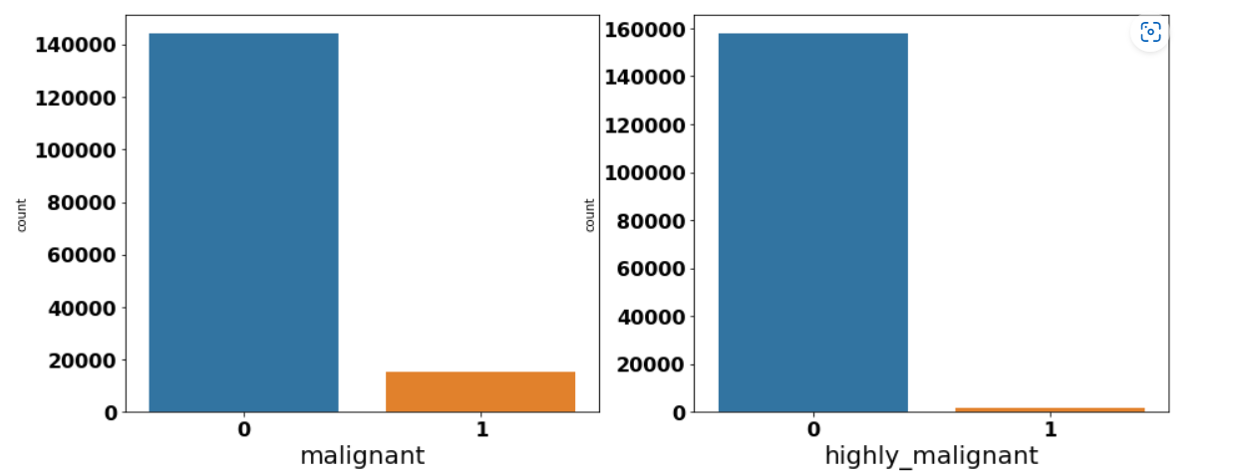
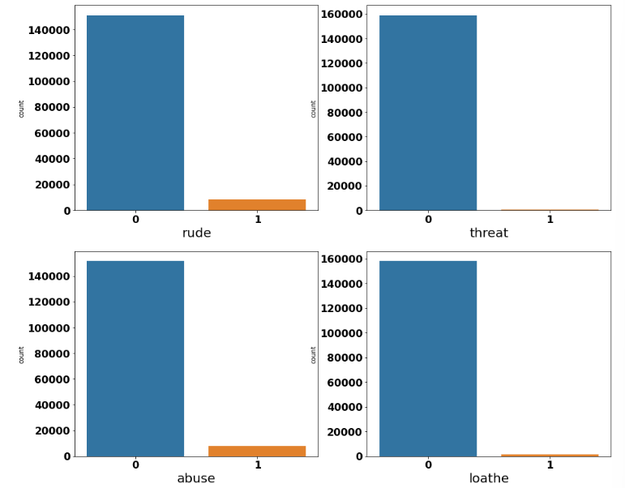
Analytical Problem Framing
We can see that there only minimum number of columns in 'malignant', 'highly malignant', 'rude', 'threat', 'abuse', 'loathe' and remaining all in 0.

Slide 5
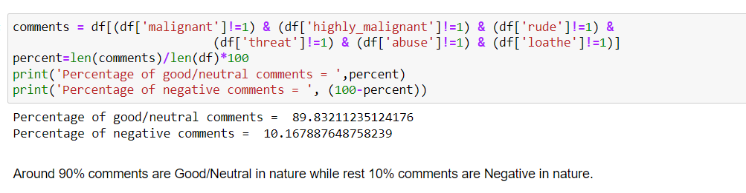
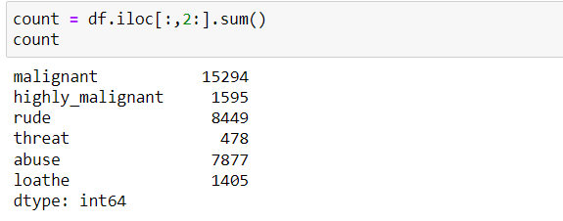
Analytical Problem Framing

Slide 6
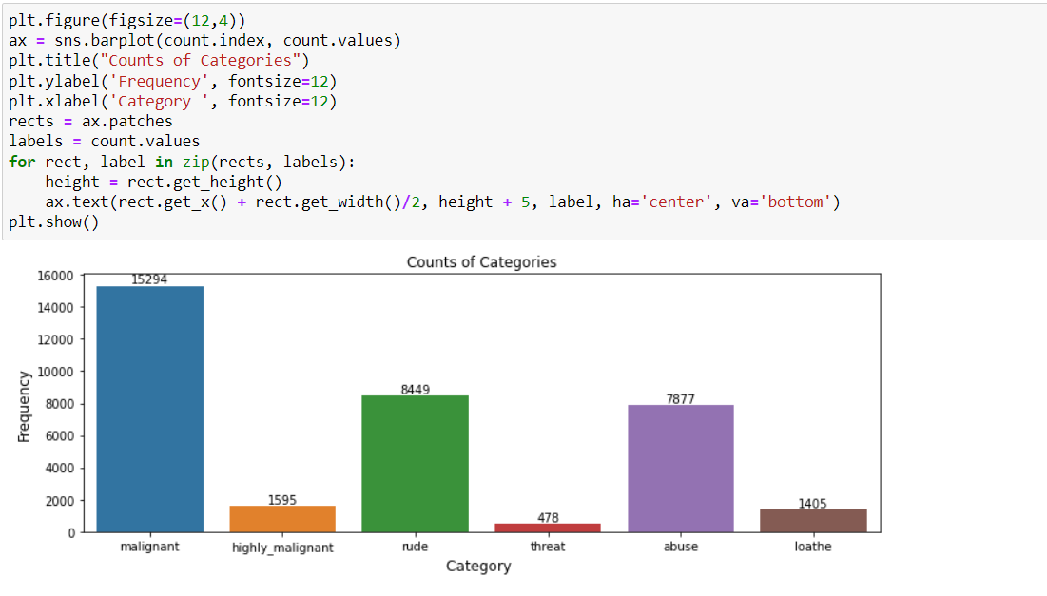
Analytical Problem Framing
Out of total Negative comments the maximum negative comments come with Malignant in nature followed by rude categories.
Around 90% comments are Good /Neutral in nature while rest 10% comments are Negative in nature.
Very few comments come with threatening nature.

Slide 7
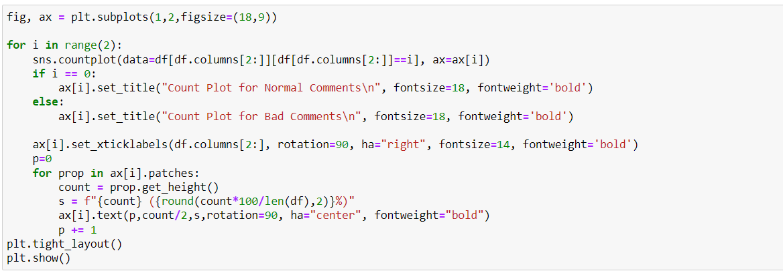
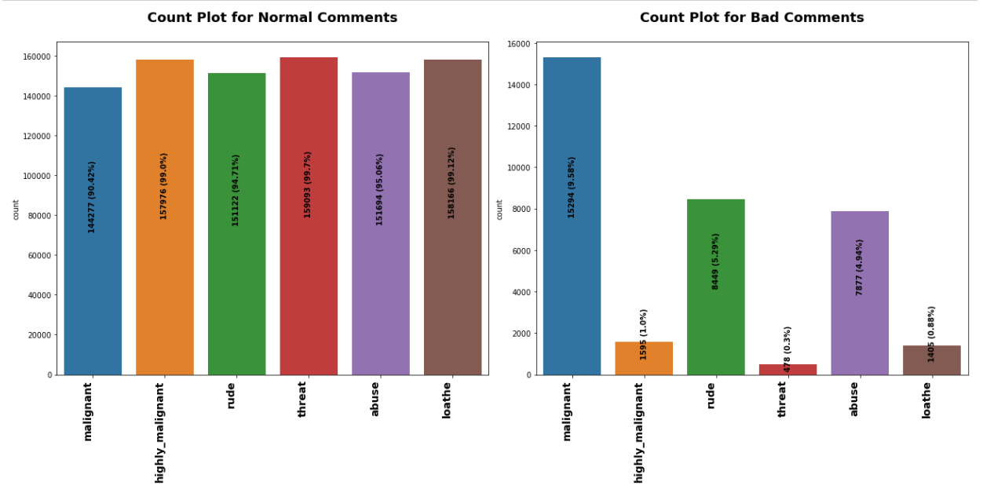
Analytical Problem Framing

Slide 8
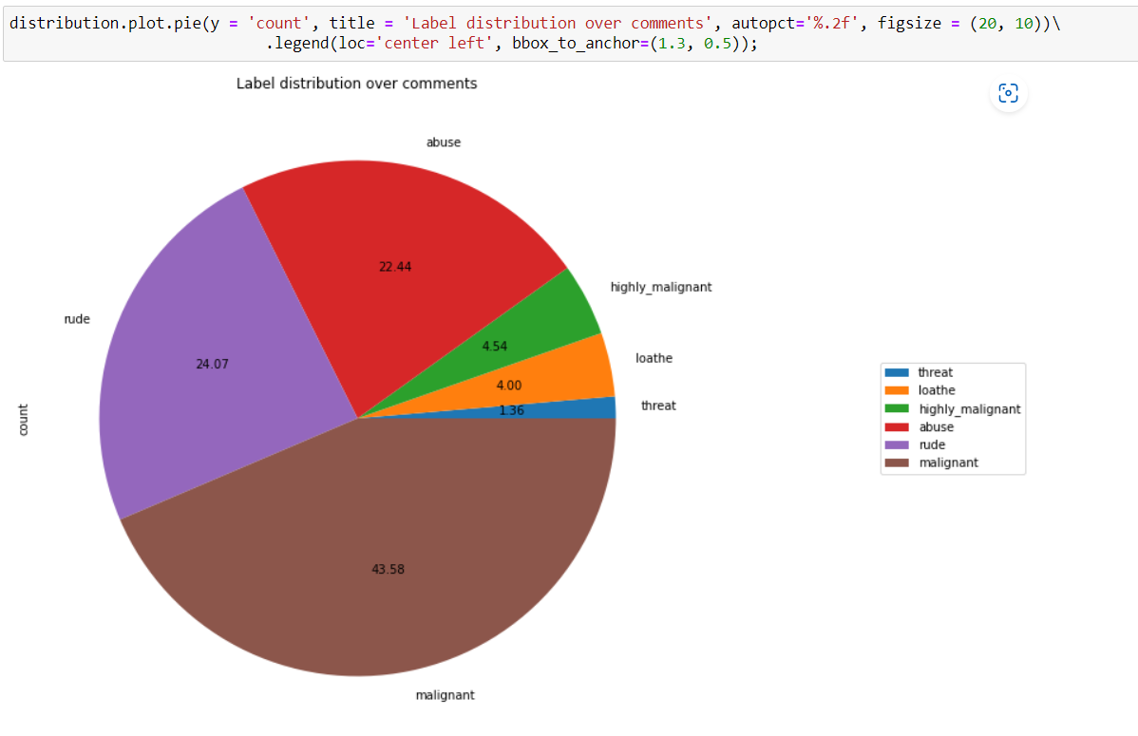
Analytical Problem Framing Out of total negative comments around 43.58% are malignant in nature followed by 24.07% are rude comments

Slide 9
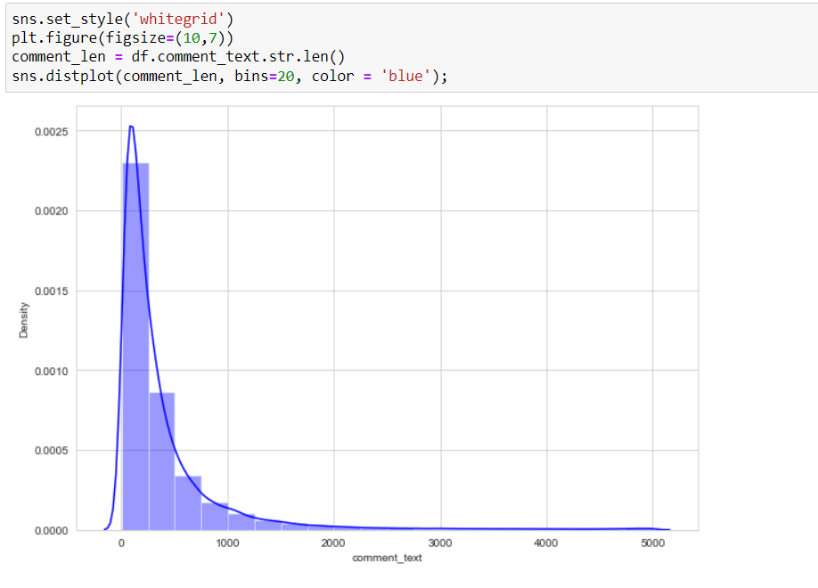
Analytical Problem Framing
Above is a plot showing the comment length frequency. As noticed, most of the comments are short with only a few comments longer than 1000 words.
Majority of the comments are of length 500, where maximum length is 5000 and minimum length is 5. Median length being 250.

Slide 10
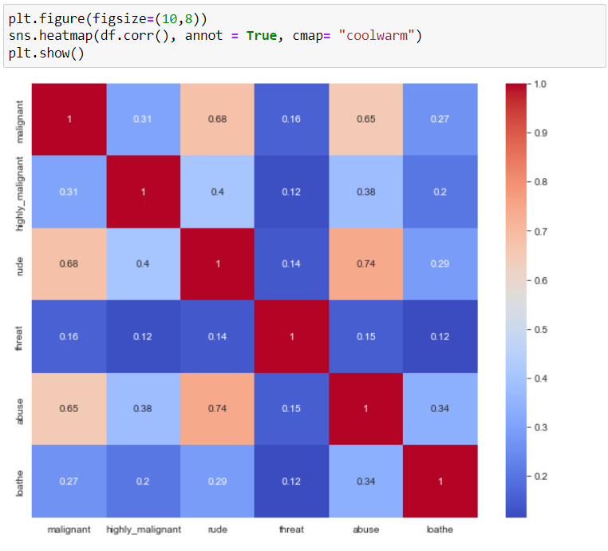
Analytical Problem Framing
We can see more corelations in the variables, Abuse have more corelation with malignant and rude.
Rude has more positive corelation with malignant
We don’t have any negative corelations in the data.

Slide 11
DATA sources and their formats
The data set includes:​
Malignant: It is the Label column, which includes values 0 and 1, denoting if the comment is malignant or not.​
Highly Malignant: It denotes comments that are highly malignant and hurtful.​
Rude: It denotes comments that are very rude and offensive.​
Threat: It contains indication of the comments that are giving any threat to someone.​
Abuse: It is for comments that are abusive in nature.​
Loathe: It describes the comments which are hateful and loathing in nature.​
ID: It includes unique Ids associated with each comment text given.​
Comment text: This column contains the comments extracted from various social media platforms.​

Slide 12
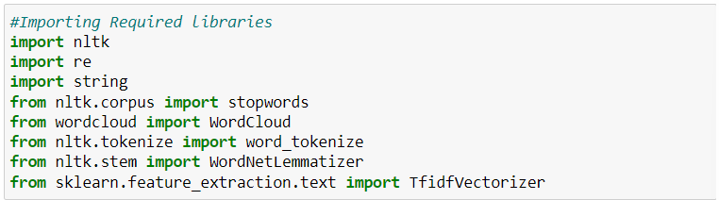
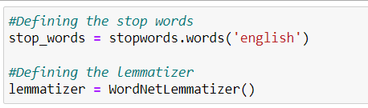
Data Cleansing
I imported all the required libraries for cleansing the data.
After importing all the required libraries, I have defined stopwords and lemmatize to a variable.

Slide 13
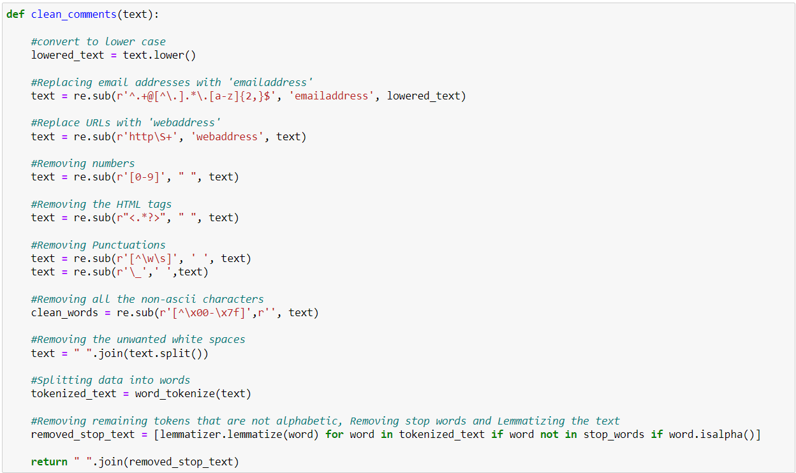
Data Cleansing
Post which I have defined a function for cleaning the data.

Slide 14
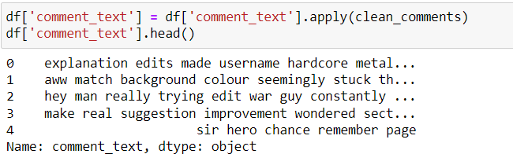
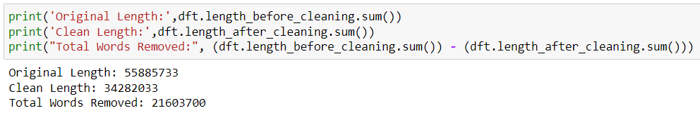
Data Cleansing
Post on creating a function I have passed my data into the same to clean it.

Slide 15
Word Cloud for getting word sense
Word Cloud is a visualization technique for text data wherein each word is picturized with its importance in the context or its frequency.
The more commonly the term appears within the text being analysed, the larger the word appears in the image generated.
The enlarged texts are the greatest number of words used there and small texts are the smaller number of words used.

Slide 16
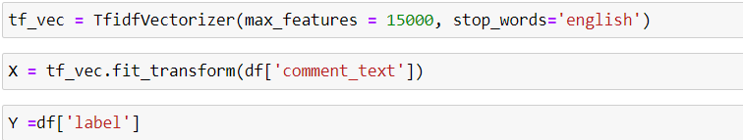
Word to Vec
I have split the data into two parts X and y and made them ready for training. I have created a new feature name label and summed all the other numerical column and changed the output as binary i.e., if the sentence is categorised as malignant it will be 1 or else it will be 0

Slide 17
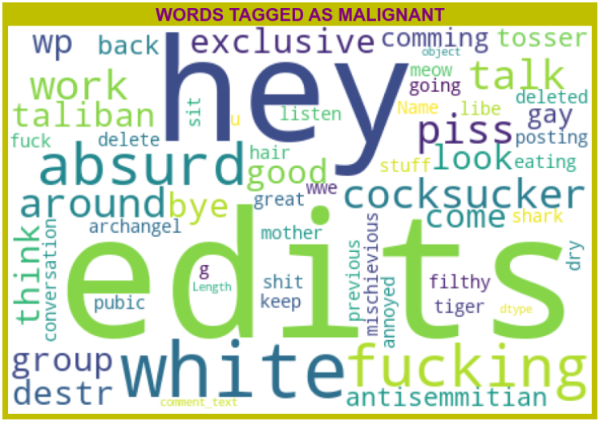
Word Cloud
We can see the foul words that are mostly used in malignant classified sentences we are seeing top 400 words the words which are bigger in size are mostly used.

Slide 18
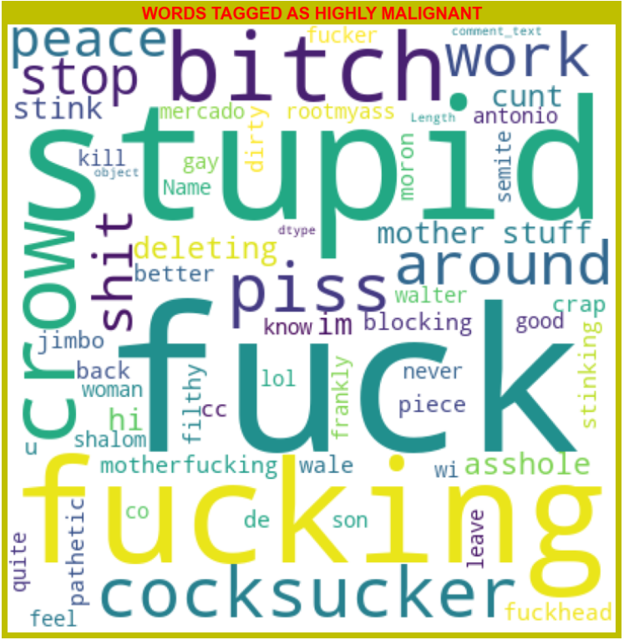
Word Cloud
We can see the foul words that are mostly used in highly malignant classified sentences we are seeing top 400 words the words which are bigger in size are mostly used.

Slide 19
Word Cloud
We can see the words that are mostly used in highly_malignant classified sentences we are seeing top 400 words. The words which are bigger in size are mostly used.

Slide 20
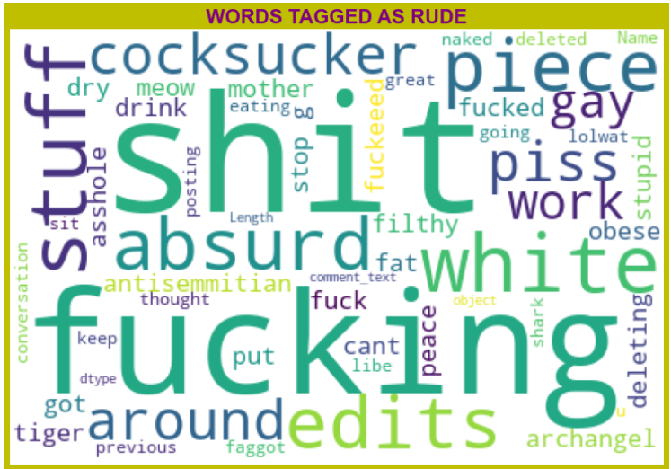
Word Cloud
We can see the words that are mostly used in Rude classified sentences we are seeing top 400 words. The words which are bigger in size are mostly used.

Slide 21
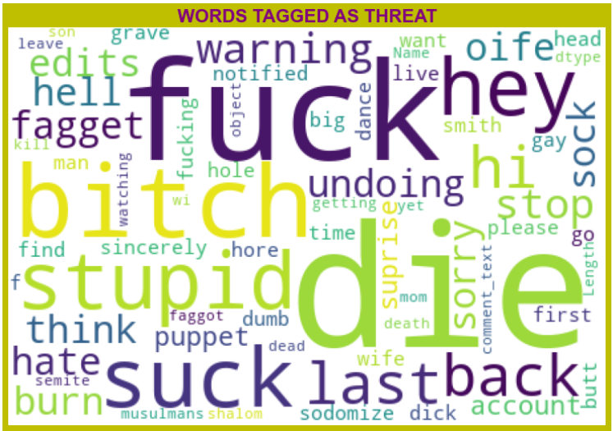
Word Cloud
We can see the words that are mostly used in Threat classified sentences we are seeing top 400 words. The words which are bigger in size are mostly used.

Slide 22
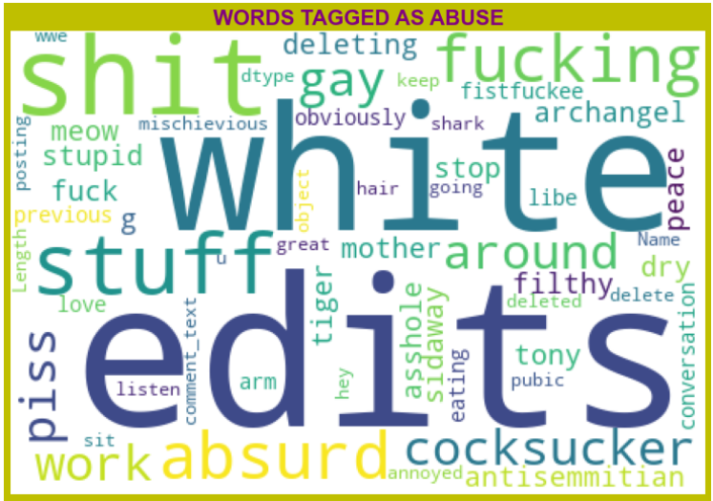
Word Cloud
We can see the words that are mostly used in Abuse classified sentences we are seeing top 400 words. The words which are bigger in size are mostly used.

Slide 23
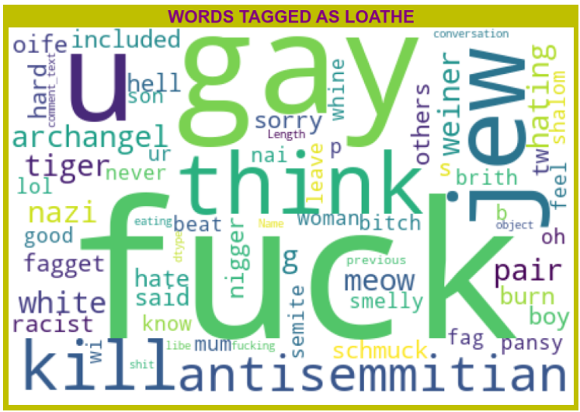
Word Cloud
We can see the words that are mostly used in Loathe classified sentences we are seeing top 400 words. The words which are bigger in size are mostly used.

Slide 24
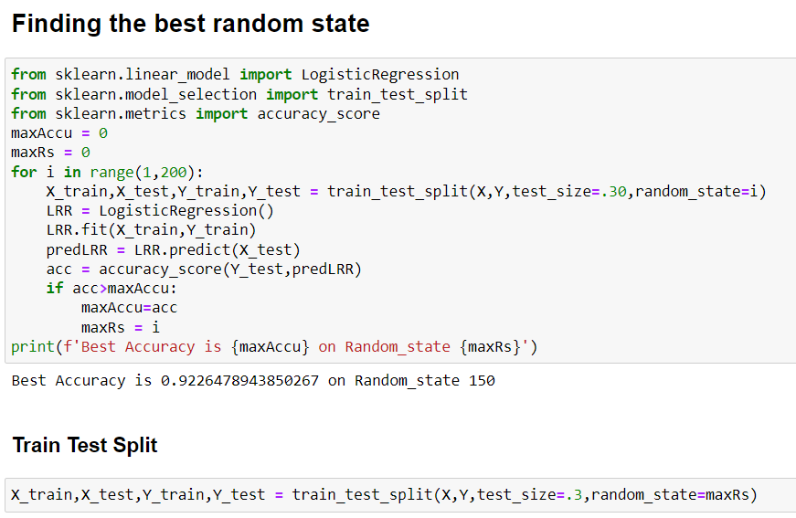
Model's Development and Evaluation
We can see the words that are mostly used in Loathe classified sentences we are seeing top 400 words. The words which are bigger in size are mostly used.
After selecting the best random state parameter, I have spitted the data into test and train with test size as 30 %. Again, I have imported the required libraries to import my ML algorithms.

Slide 25
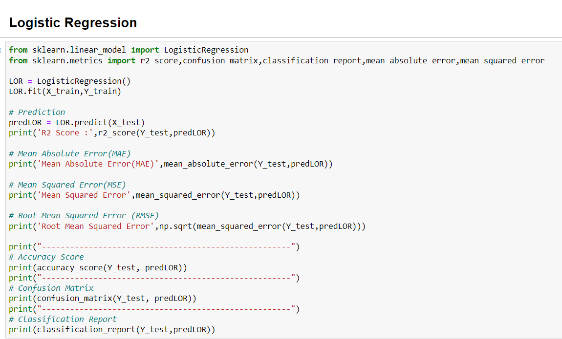
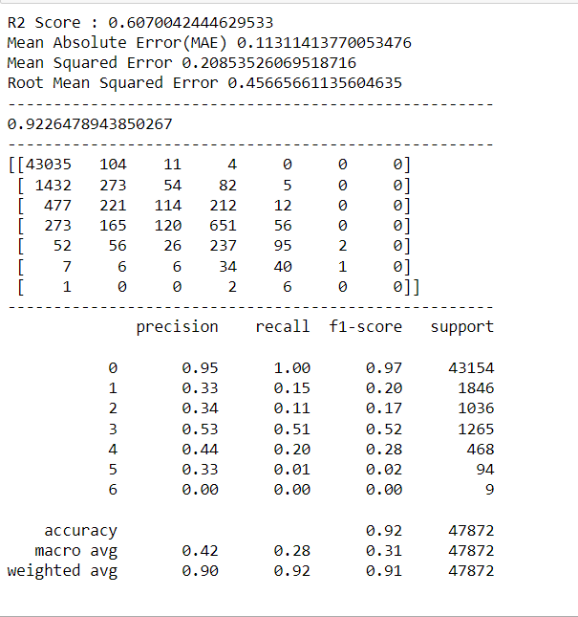
Model's Development and Evaluation

Slide 26
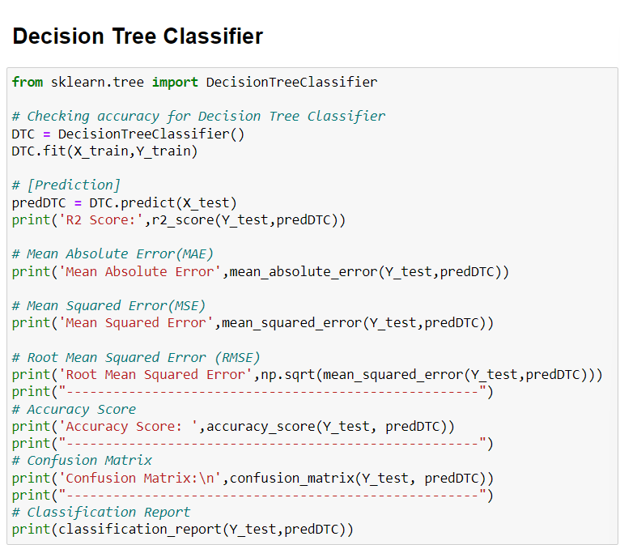
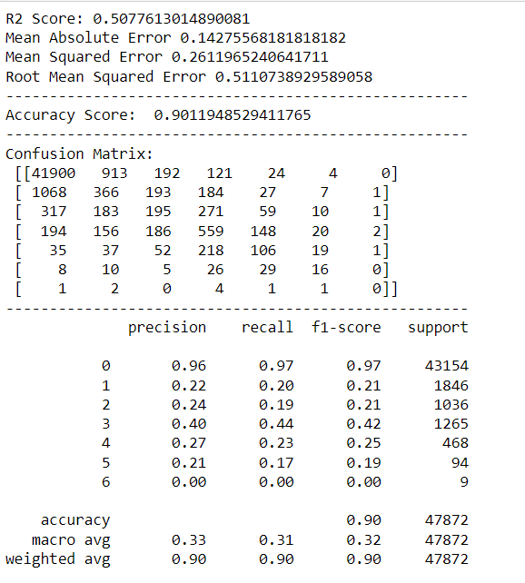
Model's Development and Evaluation

Slide 27
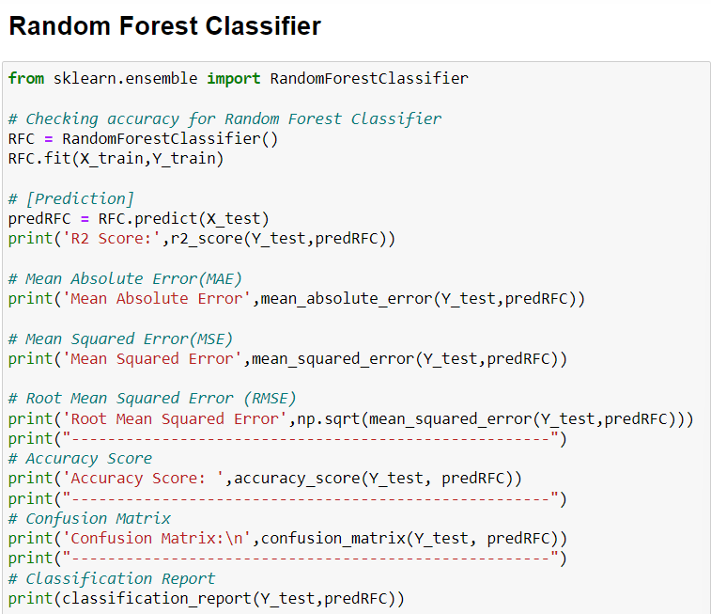
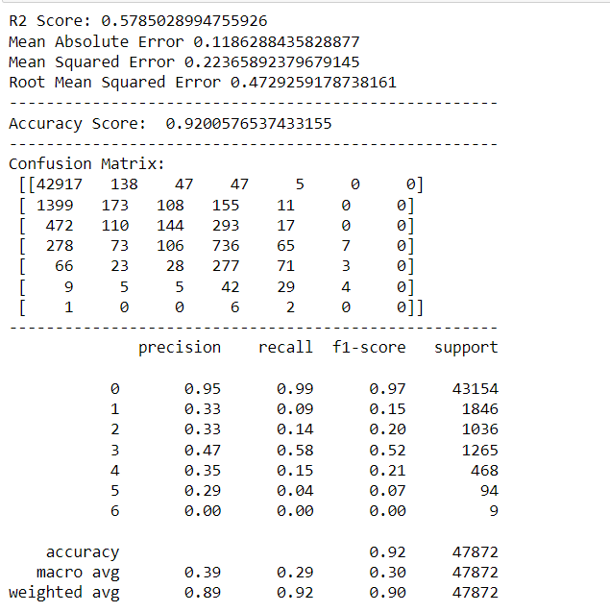
Model's Development and Evaluation

Slide 28
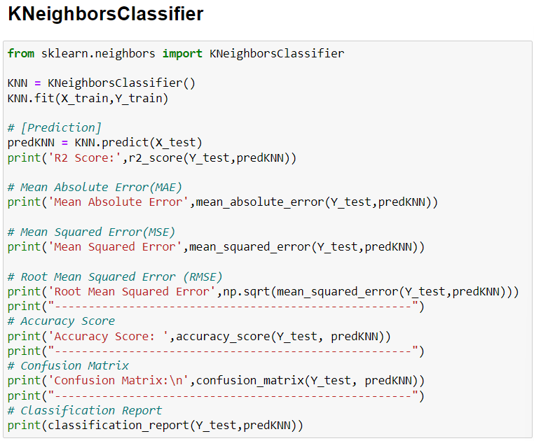
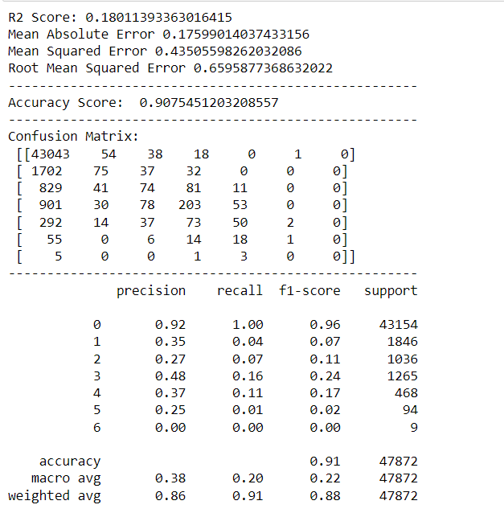
Model's Development and Evaluation

Slide 29
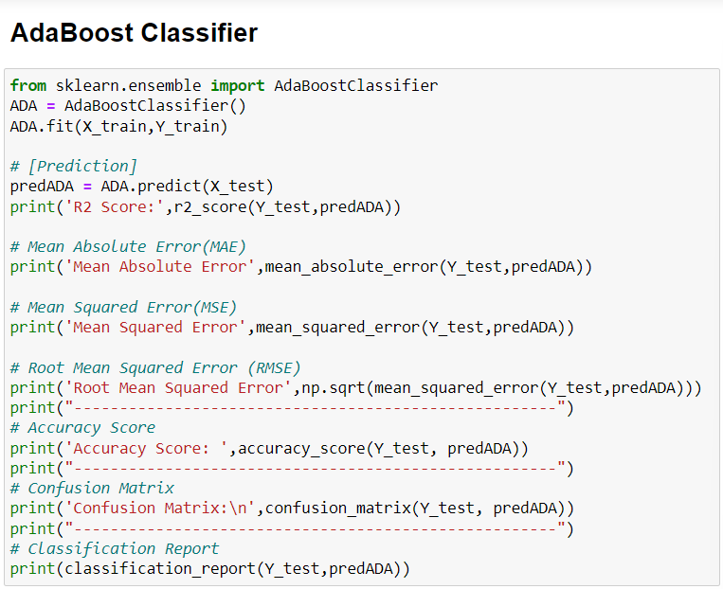
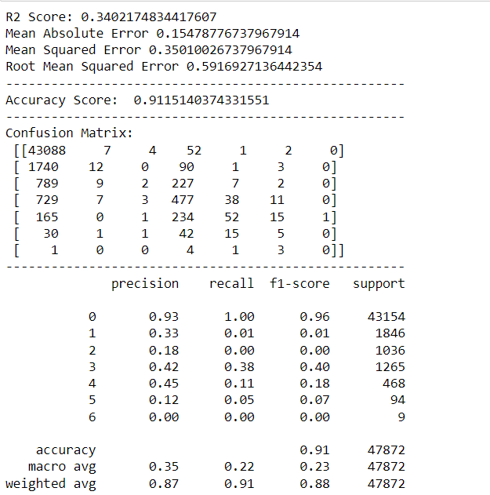
Model's Development and Evaluation

Slide 30
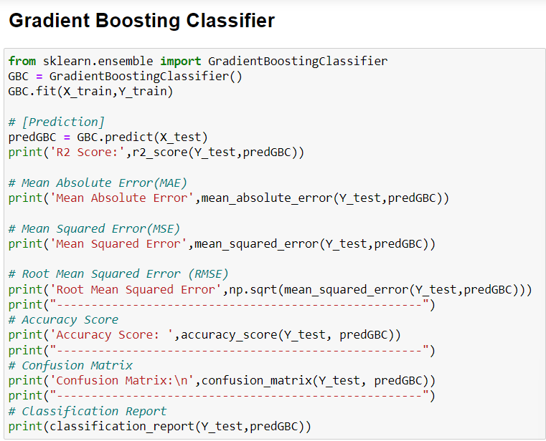
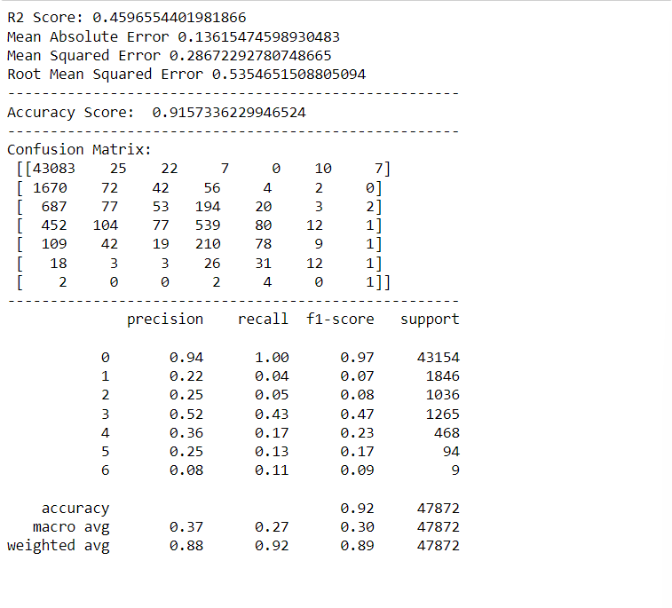
Model's Development and Evaluation

Slide 31
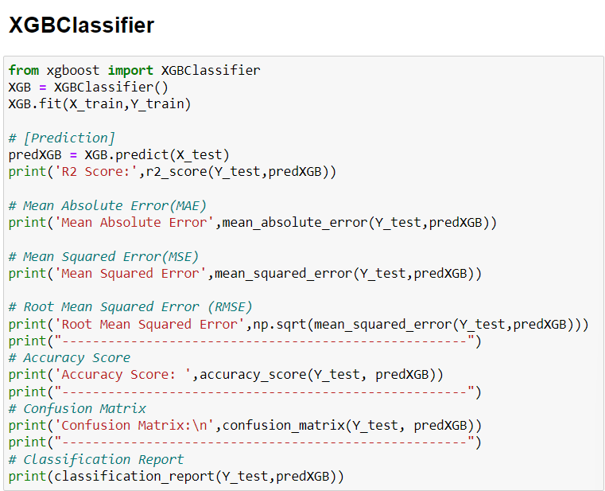
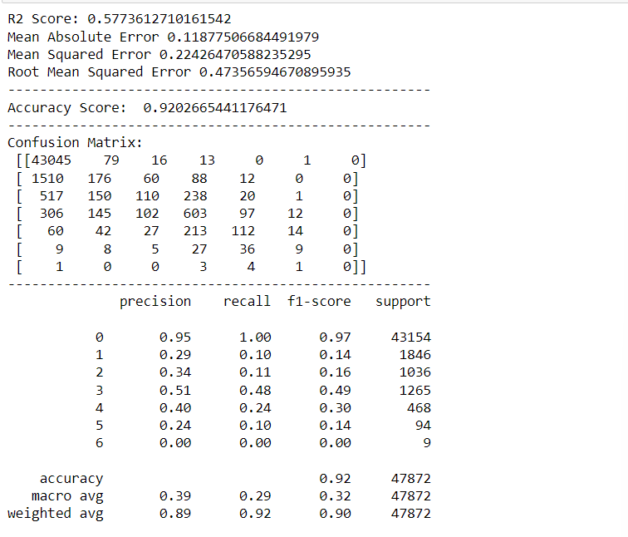
Model's Development and Evaluation

Slide 32
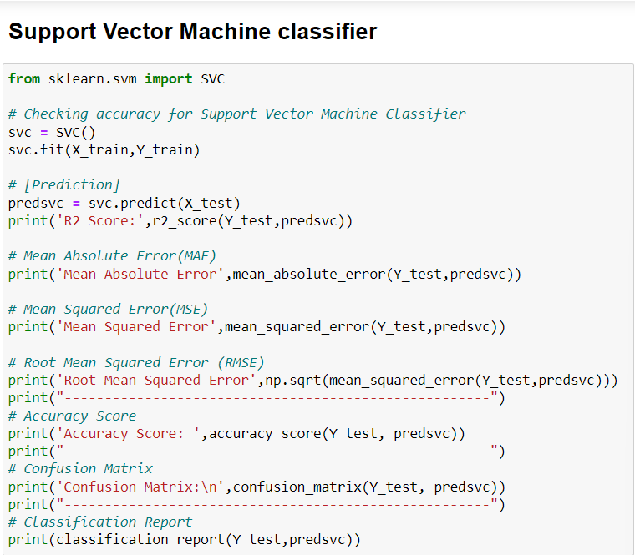
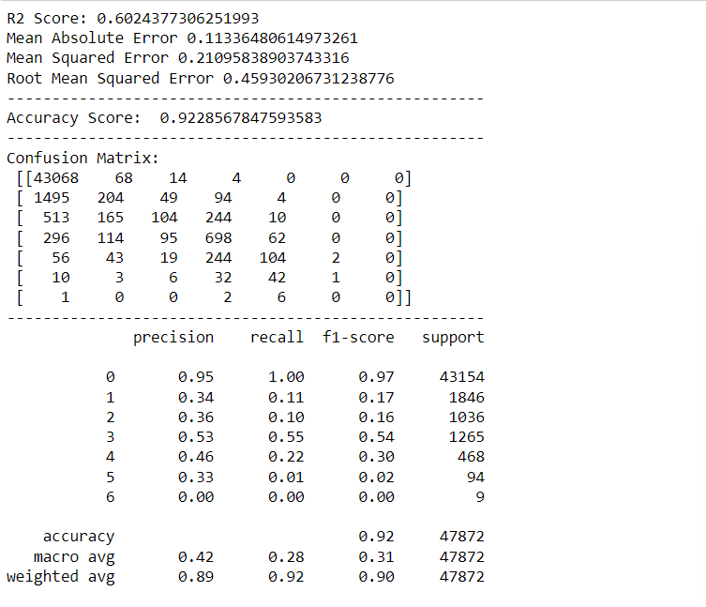
Model's Development and Evaluation

Slide 33
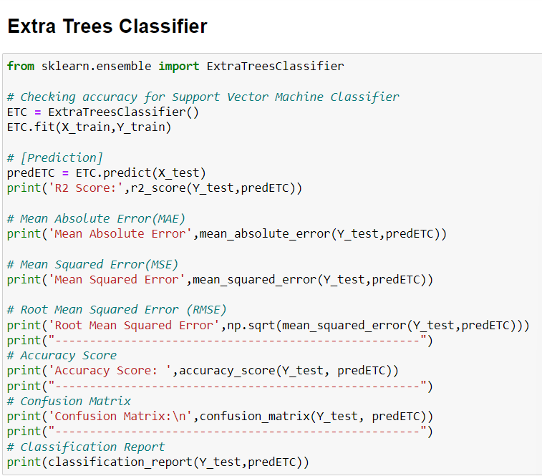
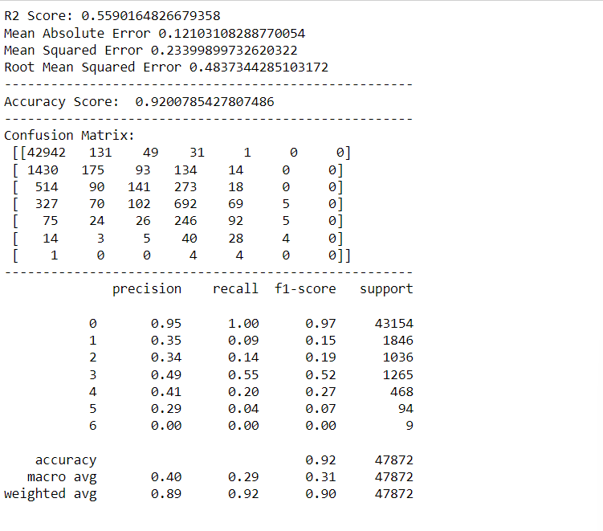
Model's Development and Evaluation

Slide 34
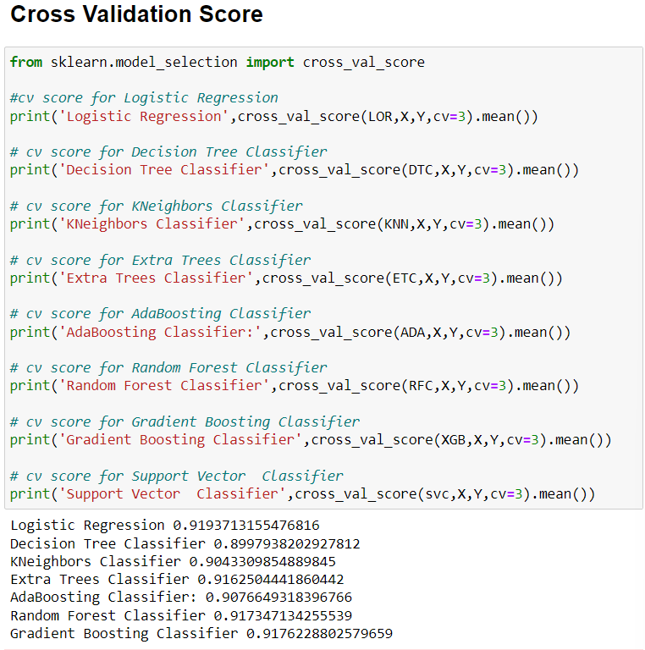
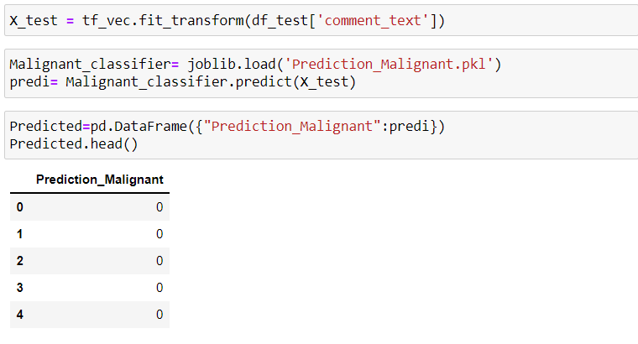
As we can see above ExtraTrees Classifier tops the chart, I have selected ExtraTrees Classifier model as my final model and I have saved the same for the further usage. Further I have imported the test data and have done prediction on the same.

Slide 35
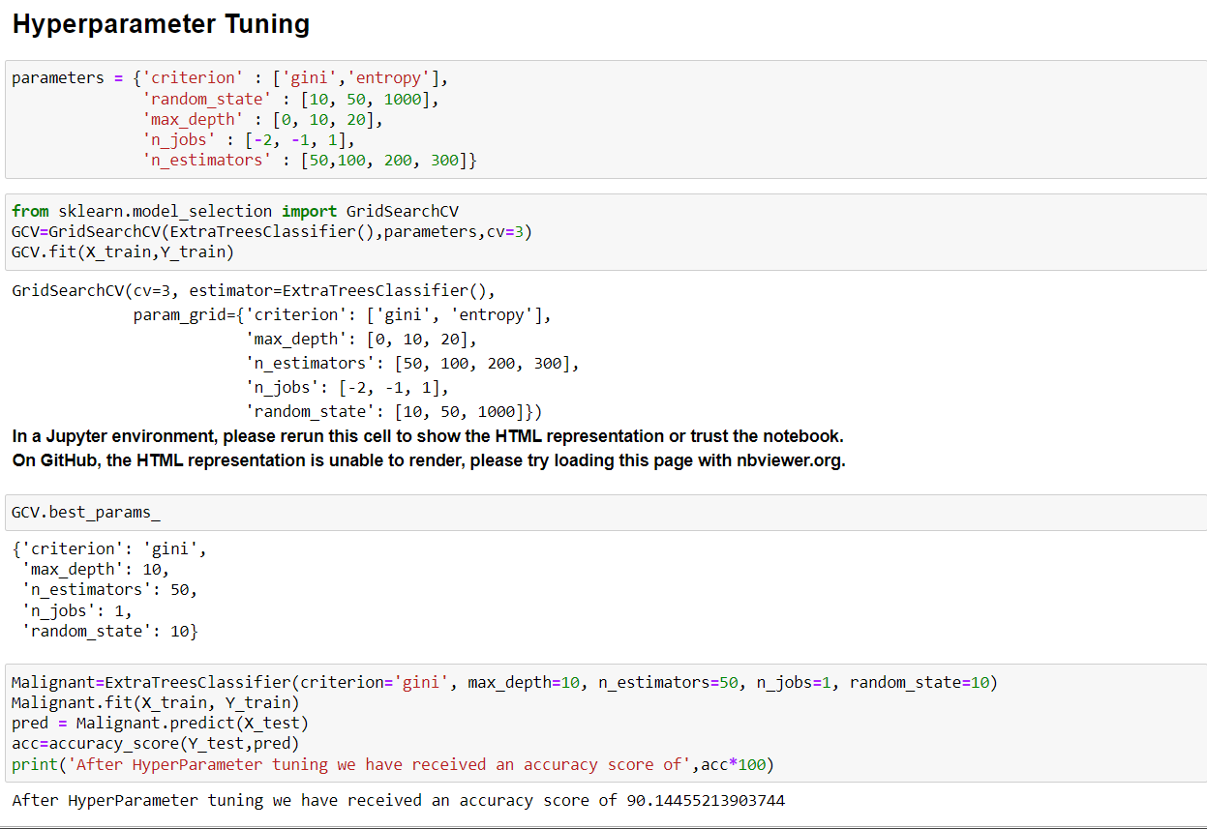

Slide 36
Conclusion
Key Findings and Conclusions of the Study
The finding of the study is that only few users over online use unparliamentary language. And most of these sentences have more stop words, and are being long. As discussed before few motivated disrespectful crowds uses these foul languages in the online forum to bully the people around and to stop them from doing the things that they are supposed to do. Our Study helps the online forms and social media to induce a ban to profanity or usage of profanity over these forms.

Slide 37
Conclusion
Learning Outcomes of the Study in respect of Data Science
I have developed our system based on a foul language classification approach; it is based on an improved version of a Random Forest Classification Algorithm that detects offensive language usage in a conversation. As per our evaluation, we found that lesser number of users conversation is not decent all the time. We trained 159571 observations for eight context categories using a Random Forest algorithm for context detection. Then, the system classifies the use of foul language in one of the trained contexts in the text conversation. In our testbed, we observed 10% of participants used foul language during their text conversation. Hence, our proposed approach can identify the impact of foul language in text conversations using a classification technique and emotion detection to identify the foul language usage

Slide 38
Conclusion
Limitations of this work and Scope for Future Work
The limitation of the study is that we have an imbalanced data so our model learnt more about the non-abusive sentence more than the abusive sentence. Which makes our model act like an overfit model when tested with live data. And also, model tend to not identify a foul or a sarcastically foul language.
The Maximum feature used while vectorization is 2000. Employing more feature in vectorization lead to more accurate model which I not able to employed due computational resources.
Data is imbalanced in nature but due to computational limitation we have not employed balancing techniques here.
Deep learning CNN, ANN can be employed to create more accurate model.

Slide 39
Thank You

